Slide 1
Discovery Cluster Overview
John Hudson

Slide 2
What is this presentation about?
About me
What is a HPC cluster?
History of discovery
How to access the resources

Slide 3
John Hudson Systems Administrator

Slide 4
About me
I was born in New England and grew up on a Farm in Quechee, VT.
I have two wonderful kids Margot, and Roman (5&7)
I enjoy riding my motorcycle, hiking, and just about anything that involves fitness.
This year I will have worked at Dartmouth longer than I have not worked at Dartmouth =D

Slide 5
How did a farm boy from VT find his way into HPC?

Slide 6
Doom

Slide 7
Work History
This year I will have worked at Dartmouth a total of 15 years. (+2 years as a temp)
[2004-06] I started work at the Tuck school of business as a temporary employee
[2006-09] I started officially working at Dartmouth in the Computer store.
[2009-11] I started working as a machine room coordinator in the server room
[2011-14] I started working as a systems administrator on the discovery cluster
[2014-current] I started my role as a systems administrator in Research Computing

Slide 8
Cyberinfrastructure
John Hudson
William Hamblen
Elijah Gagne
John Gilman
Richard Brittain – Fall 1990
Bill Hamblen– July 29th, 1999
Combined 103 years of IT service in the Dartmouth community
John Gilman – Aug 1st, 1999
Richard Brittain
Elijah Gagne – Dec 4th, 2006
John Hudson – Nov 2007

Slide 9
Important concept
Shared memory
Distributed memory
Shared memory: multiple threads of a process run on a single node – All the data can be accessed by all the threads in the regular way.
Distributed memory: multiple processes run on multiple nodes. Processes only have access to data on the node – Use a “communication library” to access data on other nodes .
Interconnect
Interconnect
Memory

Slide 10
Important concept
Distributed memory
Distributed memory: multiple processes run on multiple nodes. Processes only have access to data on the node – Use a “communication library” to access data on other nodes .
Shared memory
Shared memory: multiple threads of a process run on a single node – All the data can be accessed by all the threads in the regular way.
Step 2
Interconnect
Step 1
Memory

Slide 11
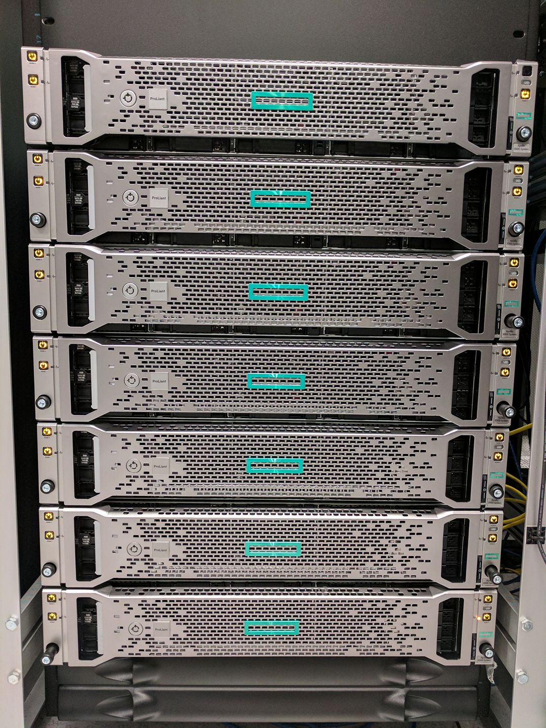
What is a HPC cluster?

Slide 12
What do HPC cluster entail?
High-performance computing is fast computing – Computations in parallel over lots of compute elements (CPU, GPU) – With a very fast network to connect between the compute components.
Hardware -- Computer Architecture • Distributed Systems, Network switches
Networking / Interconnects -- InfiniBand, Ethernet
Storage -- Network attached storage (NAS)
Operating system -- red hat, fedora, centOS, rocky
Software -- Python R MPI (Message Passing Interface) matlab
Open source, commercial

Slide 13
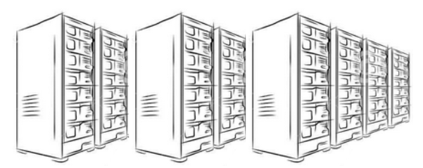
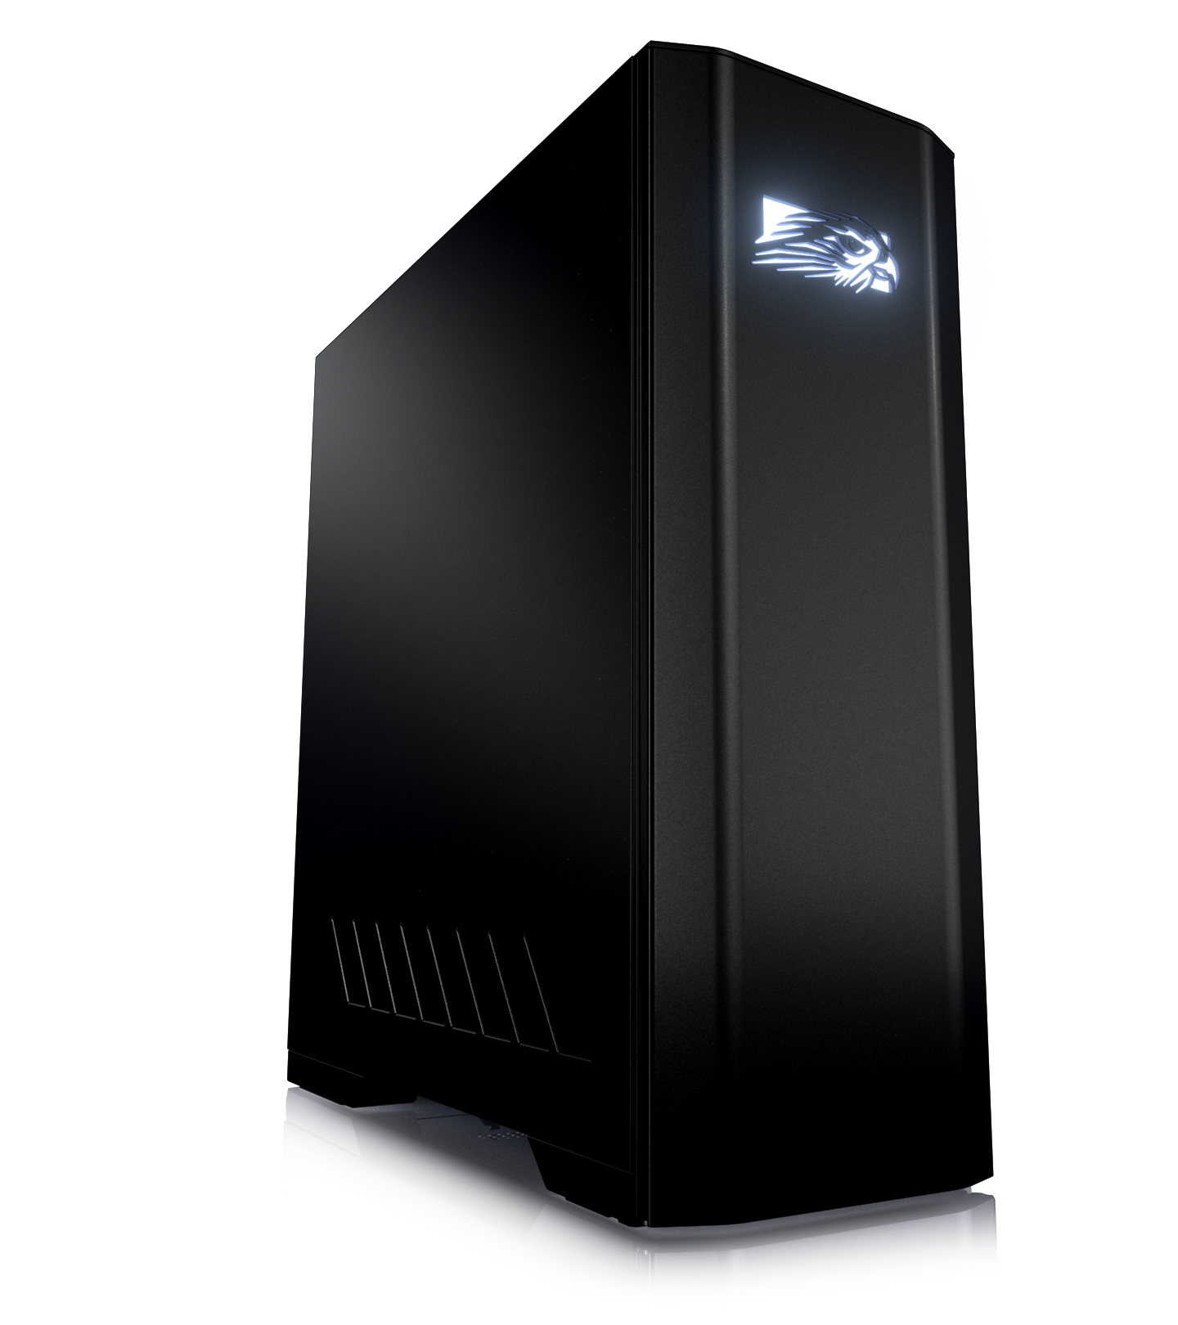
HPC Cluster Explanation
The cloud!
High performance compute cluster
Desktop PC
Job Scheduler
Software applications
Software applications
OS
OS
Network
Infiniband
Network
GPU card
GPU card
Processor/CPU
Processor/CPU
Memory
Memory
Hard Drive
NAS
Hard Drive
People

Slide 14
Shared VS. Distributed
Shared
Distributed

Slide 15
Shared VS Distributed
A
B
A
B
Step 1

Slide 16
Types of HPC environments
On premises
Cloud
Hybrid
Servers and storage are located on premises. Typically, inside a local data center
Servers and storage are hosted by a cloud service.
GCP, AWS
Servers and storage are located both on premises and in the cloud.

Slide 17
Cluster Timeline / History
2005
2010
2014
2021
Hardware: PSSC
Scheduler: Maui/Torque
OS: Fedora
Nodes: 54 Cores: 216
Storage: 45TB
Hardware: HPE/Dell
Scheduler: Moab/torque
OS: Red Hat 5
Nodes: 80 Cores: 1200
GPU’s: 2
Storage: 90 TB
Hardware: HPE/Dell
Scheduler: Moab/torque
OS: CentOS 6
Nodes: 128 Cores: 2000
GPU’s: 5
Storage: 465TB
Hardware: HPE/Dell
Scheduler: Slurm
OS: CentOS 7
Nodes: 168 Cores: 3023
GPU’s: 36
Storage: 2+ PB

Slide 18
Fun facts: Original Quote
Total cost to build the cluster in 2005: $252,350
Estimated Total cost of the cluster today + Isilon (NAS): 2.1 Million

Slide 19
Fun Facts Continued
16 Active members March 2014
139 active members March 2021

Slide 20
When do we need HPC
Geography: The Geography department is utilizing the discovery cluster to run weather simulations across multiple compute nodes on very large datasets generated from NASA to try and predict weather patterns.
Molecular Pathology Norris Cotton Cancer Center: Is utilizing the discovery cluster as a proof of concept to move forward with clinical trials. A use case is to utilize machine learning on GPU resources to automate the assembly of 3D models.

Slide 21
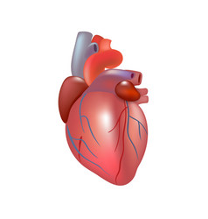
use case
1-3 Days
queue
20-40min
9-5PM

Slide 22
Applying a new approach using the cluster
Image Repository
Same day results
Minutes per model

Slide 23
How do I obtain access?
Visit: rc.dartmouth.edu

Slide 24
Where can I find help?
Services.dartmouth.edu (Knowledge base)

Slide 25
Thank you!!!!

